Slide 1

HOSPITAL MANAGEMENT SYSTEM
Group Members:
Sai Satya Pavan Pandu Vanka
Anusha Yaramala
Rangineni Vishwitha
Chennareddy Muni Deepak Kumar
Dinesh Reddy Puthalapattu
Ganjinaboina Tejaswi
Chandrupatla Divya Anusha
Makala Jaswanth

Slide 2
Project Overview
The Hospital Management System is an innovative project designed to transform the way hospitals operate, making healthcare management more integrated, efficient, and patient-centered.
By leveraging advanced technology, the system simplifies complex operational tasks, enabling healthcare providers to focus more on delivering quality patient care.
The project aims to provide a comprehensive platform that supports all aspects of hospital management, including patient records, appointments, billing, and inventory, through a user-friendly interface.

Slide 3
Team Introduction
Documentation Specialist – (Divya) : Tasked with the meticulous documentation of project phases, ensuring clarity and accessibility of information for all stakeholders.
System Architect- ( Deepak ): Designs and oversees the implementation of a scalable, secure, and robust system architecture that forms the backbone of our HMS.
Requirement Analyst – (Vishwitha): Acts as the liaison between healthcare professionals and our technical team to ensure all system requirements align with real-world healthcare needs.
Frontend Developer - (Anusha): Focuses on creating an intuitive, engaging, and accessible user interface that enhances user experience for both patients and healthcare providers.

Slide 4
Team Introduction
Backend Developer ( Pavan & Dinesh): Develops the server-side logic and database management, ensuring efficient, secure data handling and seamless integration with the frontend.
Database Administrator (Tejaswi & Jaswanth): Specializes in designing, implementing, and maintaining a robust database system, ensuring data integrity, security, and optimal performance.

Slide 5
Key Features and Functionalities
Patient Record Management: Our system provides a secure and comprehensive module for managing patient information, medical histories, and treatment records, ensuring data is easily accessible to authorized personnel.
Appointment Scheduling: We offer an intuitive interface for both doctors and patients to schedule, manage, and track appointments, aiming to reduce wait times and enhance the efficiency of healthcare services.
Billing and Inventory Management: Integrated billing and inventory management functionalities ensure financial operations are transparent and accurate, streamlining the management of resources and expenditures.
Electronic Health Records (EHR): Implementing EHR allows real-time access to patient data, improving the accuracy and quality of care by enabling informed clinical decisions.

Slide 6
Key Features and Functionalities
Telemedicine Services: Our system includes telemedicine capabilities, allowing patients to consult with healthcare providers remotely, expanding the reach and accessibility of healthcare services.
Data Security and Compliance: We prioritize the highest standards of data security and compliance with regulations like HIPAA to safeguard patient confidentiality and ensure trust in our system.
Analytics and Reporting: Advanced analytics tools within our HMS provide valuable insights into hospital operations, patient care, and financial management, supporting informed decision-making and strategic planning.

Slide 7
Development Environment
Python: Chosen for its simplicity and robustness, Python enables us to build complex algorithms for efficient data management and analysis, forming the core of our backend development.
Flask: This lightweight Python web framework facilitates rapid development and clean, pragmatic design, allowing us to build a scalable and maintainable web application.
ReactJS: For the frontend, we utilize ReactJS to develop a dynamic and responsive user interface, ensuring an engaging and seamless experience for users without page reloads.
Visual Studio Code: An IDE to start a programming the application
Figma: A Design Tool to make a basic Prototype and visualize the app

Slide 8
Development Environment
MySQL: Our choice for database management, PostgreSQL offers advanced features and reliable performance for handling complex data types and large datasets.
Cloud Hosting on AWS: Ensuring our system's scalability, reliability, and security, AWS hosting also provides the flexibility of remote access, making our HMS accessible from anywhere.
API Integration: To enhance functionality, we integrate various APIs, enabling features like calendar management and synchronization with external healthcare services, ensuring our system's interoperability within the healthcare ecosystem.

Slide 9
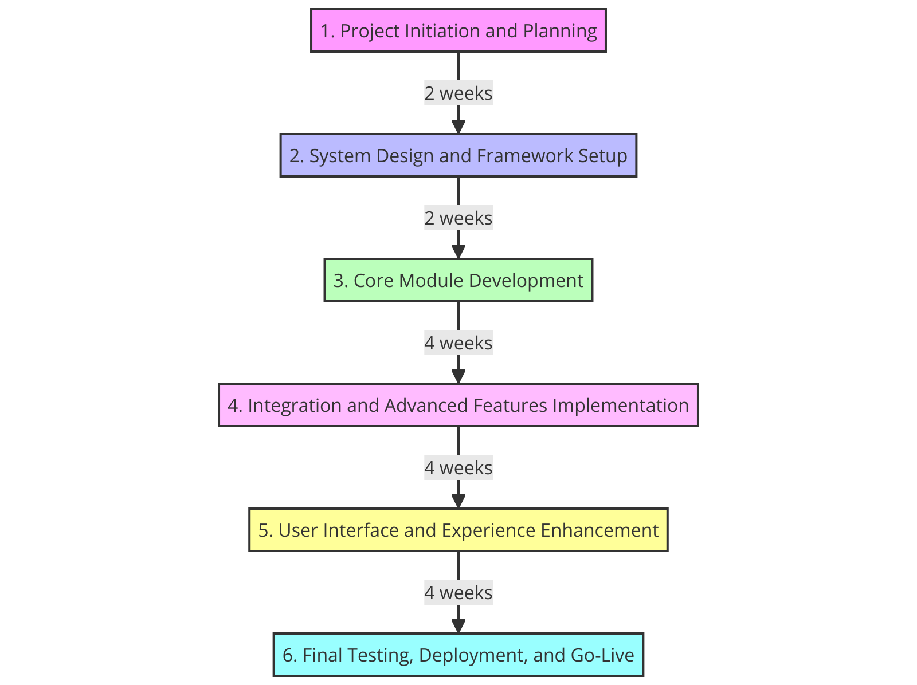
Project Timeline

Slide 10
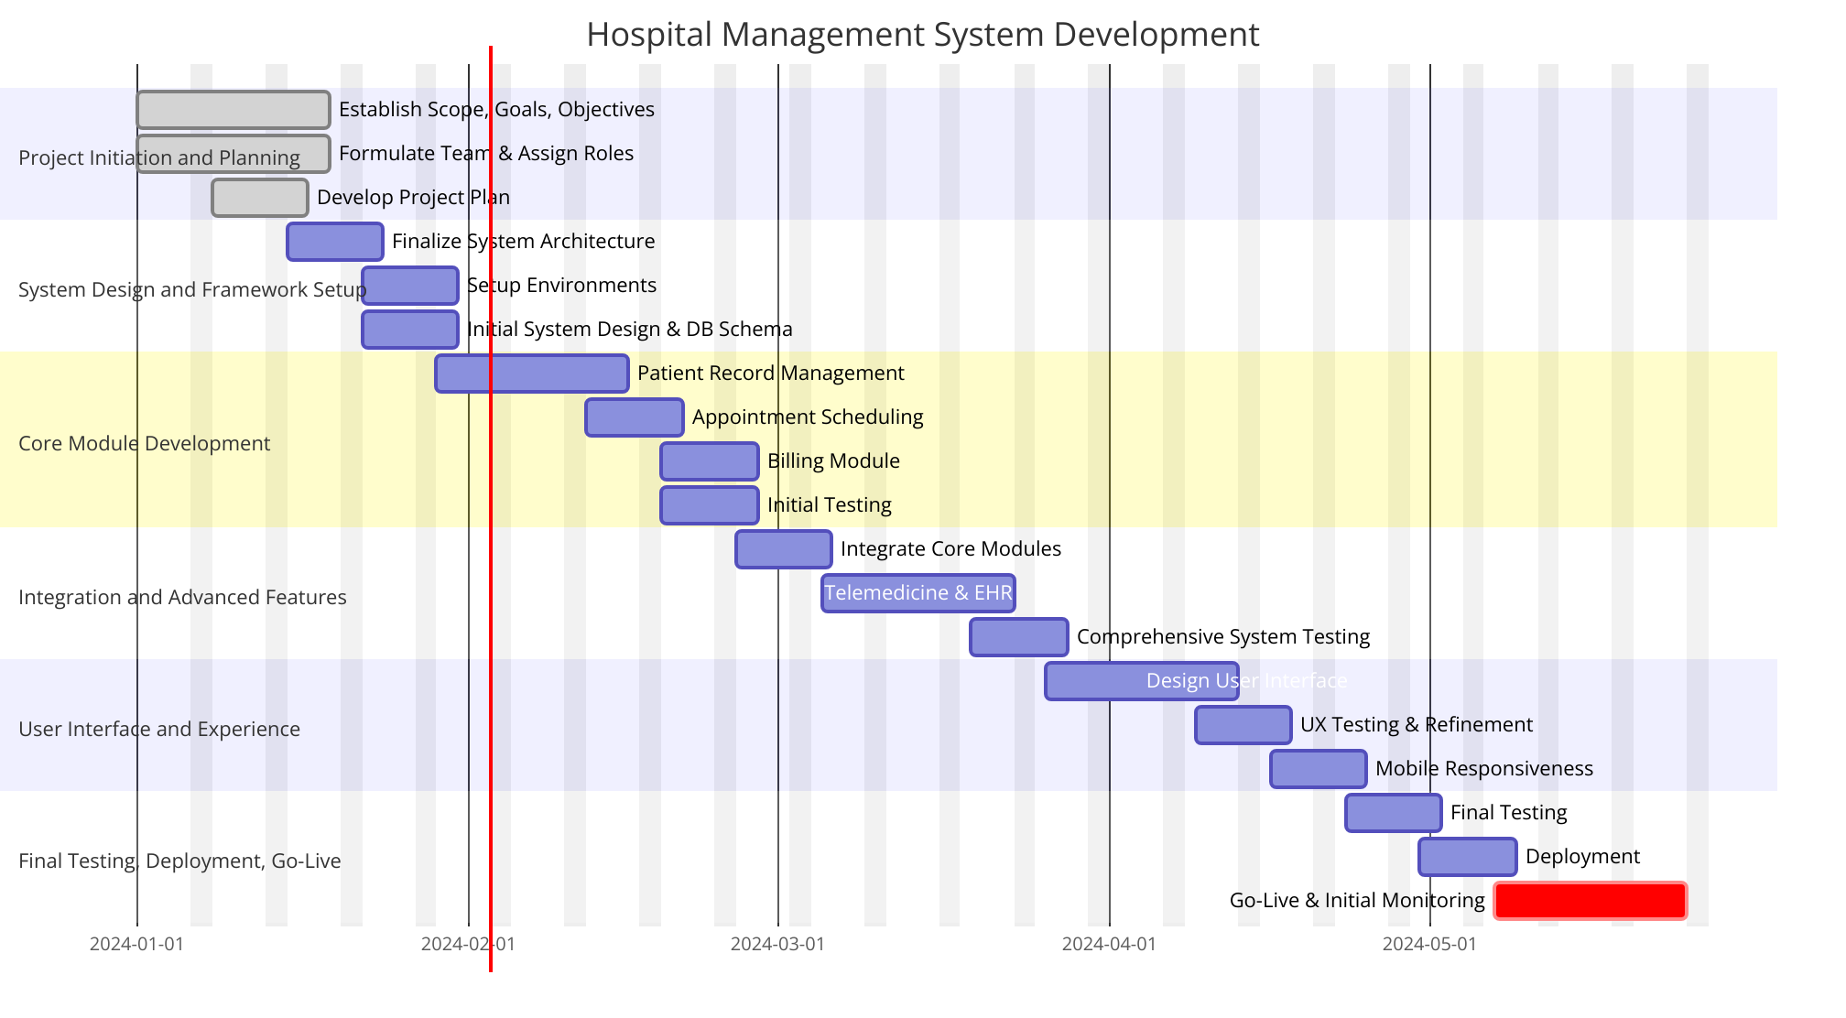
Project Gantt Chart

